Slide 1
CSE303 · STATISTICS FOR DATA SCIENCE · MINI PROJECT, SUMMER 2026
Sleep Disorder Prediction from
Lifestyle and Physiological Indicators
Md Radowan Ahmed
Shahriar Rahman
Juboraj Podder
2024-3-60-464
2022-3-60-036
2023-2-60-048
East West University — Department of Computer Science and Engineering

Slide 2
OVERVIEW
Project Abstract
This project investigates whether a person's sleep-disorder status can be predicted from everyday lifestyle and physiological indicators. Three classifiers — Logistic Regression, Decision Tree, and Random Forest — were trained on a 400-record survey dataset and compared against a majority-class baseline, after preprocessing with one-hot encoding and SMOTE oversampling for class imbalance.
400
Survey records
13
Attributes per record
Random Forest reached the highest test accuracy, while Decision Tree gave more balanced performance across the minority classes — highlighting both the potential and the limits of lifestyle-only predictors.
3
Target classes
77.5%
Best test accuracy (RF)
CSE303 — Sleep Disorder Prediction Mini Project
2

Slide 3
BACKGROUND
Motivation & Research Question
1
Motivation
?
Research Question
Sleep disorders such as insomnia and sleep apnea are widespread and closely tied to everyday lifestyle and physiological factors, including stress, physical activity, and body-weight category. Identifying which factors relate most strongly to sleep problems can support early screening before a clinical diagnosis is made.
Can a person's sleep disorder status (none, insomnia, or sleep apnea) be predicted from lifestyle and physiological indicators — age, occupation, stress level, physical activity, BMI category, blood pressure, heart rate, and daily steps?
CSE303 — Sleep Disorder Prediction Mini Project
3

Slide 4
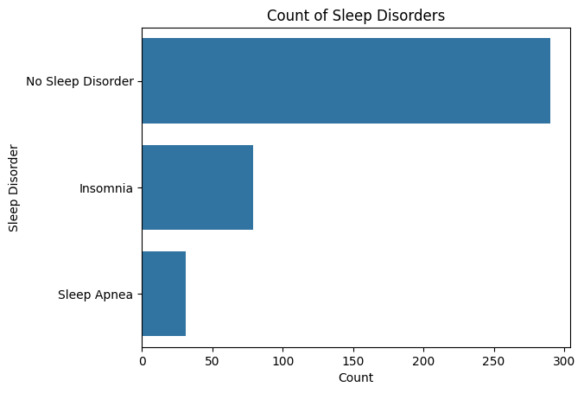
DATA
Dataset & Target-Label Construction
400 individual records, 13 attributes: Person ID, Gender, Age, Occupation, Sleep Duration, Quality of Sleep, Physical Activity Level, Stress Level, BMI Category, Blood Pressure, Heart Rate, Daily Steps, and Sleep Disorder.
Missing values in Sleep Disorder were filled with the explicit label “No Sleep Disorder” rather than dropped, since a missing entry is itself clinically meaningful.
Resulting target is imbalanced across three classes:
No Sleep Disorder
72.5%
Figure 1. Class distribution of the Sleep Disorder target.
Insomnia
19.75%
Sleep Apnea
7.75%
CSE303 — Sleep Disorder Prediction Mini Project
4

Slide 5
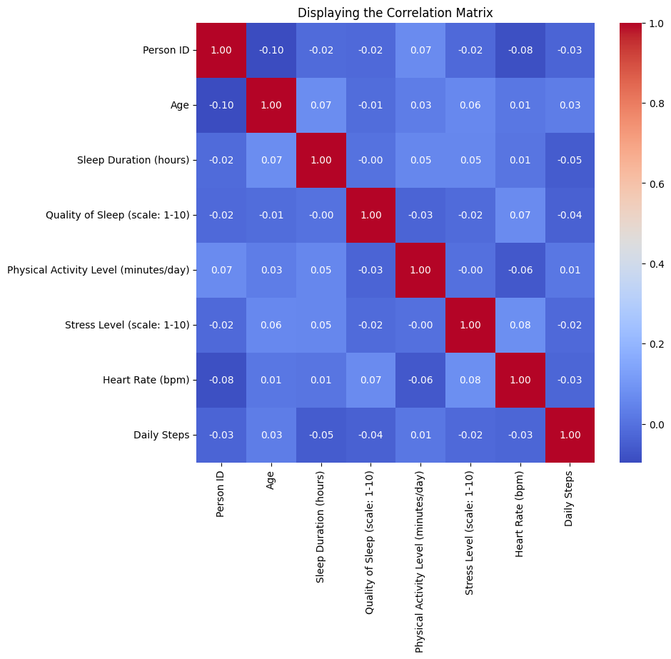
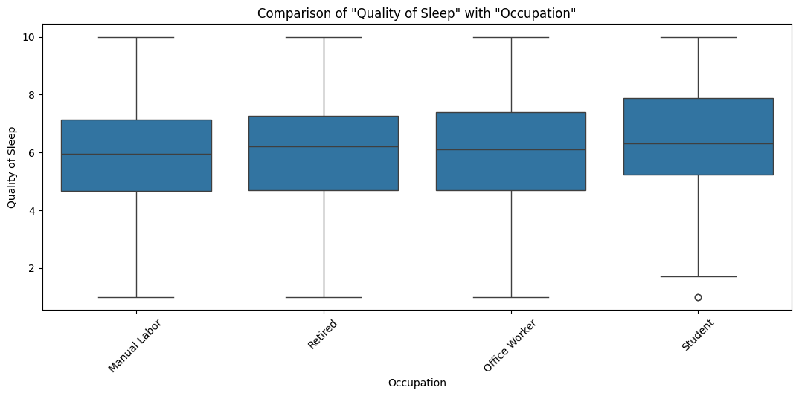
EXPLORATORY DATA ANALYSIS
Correlation & Occupation Patterns
Figure 3. Quality of Sleep across occupation groups.
Sleep Duration and Quality of Sleep show almost no linear correlation (r ≈ -0.002) — sleep quality depends on more than duration alone. Median sleep quality also visibly differs across occupations, motivating Occupation as a candidate predictor.
Figure 2. Correlation matrix of numeric variables.
CSE303 — Sleep Disorder Prediction Mini Project
5

Slide 6
METHODOLOGY
Preprocessing, Baseline & Proposed Model
Numeric features passed through unchanged; categorical features one-hot encoded. SMOTE was applied to the training data only, so minority classes (Insomnia, Sleep Apnea) were not overwhelmed during training.
BASELINES
PROPOSED MODEL
Majority-class baseline
Always predicts “No Sleep Disorder” — 72.5% accuracy, zero recall on minority classes.
Logistic Regression
A simple linear classifier used as a baseline learning algorithm.
Random Forest (50 trees)
Handles non-linear feature interactions and mixed data well; combines naturally with SMOTE inside one pipeline.
Decision Tree
Also trained as a simpler tree-based comparison point.
CSE303 — Sleep Disorder Prediction Mini Project
6

Slide 7
RESULTS
Test-Set Performance Comparison
Table 1. Test-set performance comparison across models. Split: 80% train / 20% test, 10-fold cross-validation.
Model | Accuracy | Macro F1 | Weighted F1
Majority-class baseline | 72.5% | 0.28* | 0.61*
Logistic Regression | 47.5% | 0.25 | 0.56
Decision Tree | 75.0% | 0.48 | 0.77
Random Forest (proposed) | 77.5% | 0.34 | 0.73
BEST MODEL
Random
Forest
77.5%
Random Forest achieved the highest accuracy (77.5%), while Decision Tree achieved a higher macro-F1 (0.48) — performing more evenly across minority classes. Logistic Regression performed worst (47.5%), as a linear boundary doesn't capture the relationship well.
test accuracy — highest of all models, with 50 trees on SMOTE-balanced training data.
CSE303 — Sleep Disorder Prediction Mini Project
7

Slide 8
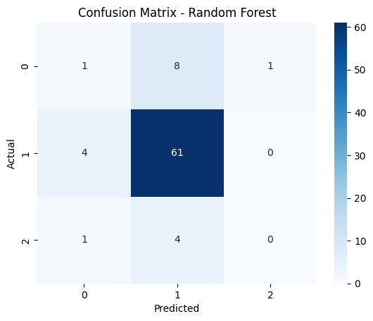
RESULTS
Model Validation
Table 2. 10-fold cross-validation accuracy (mean ± std. dev.)
Logistic Regression
42.8% ± 6.4%
Decision Tree
62.5% ± 6.6%
Random Forest (proposed)
67.5% ± 5.1%
Random Forest predicts “No Sleep Disorder” reliably but struggles on minority classes — the expected effect of class imbalance even after SMOTE.
Cross-validation confirms the same model ranking as the test set, giving confidence the results are not an artifact of a single train/test split.
Figure 4. Confusion matrix — Random Forest (proposed).
CSE303 — Sleep Disorder Prediction Mini Project
8

Slide 9
CRITICAL REVIEW
Limitations
1
Sample size is modest (400 records, 80 test), so minority-class metrics have high variance.
2
Class imbalance remains a challenge even with SMOTE; Sleep Apnea recall stayed low across all models.
3
Only classification was done; formal hypothesis tests (ANOVA) and regression were not carried out.
4
Cross-sectional survey data — associations found do not imply causation.
5
Hyperparameters were left at library defaults; no systematic grid search was performed.
6
CV accuracy is consistently lower than the single test-split accuracy, so the 80/20 split was somewhat favorable.
CSE303 — Sleep Disorder Prediction Mini Project
9

Slide 10
WRAP-UP
Conclusion
Lifestyle and physiological indicators carry some predictive signal for sleep-disorder status: a Random Forest classifier reached 77.5% test accuracy, and a Decision Tree gave more balanced performance across classes.
KEY TAKEAWAY
77.5%
Class imbalance still limits reliable detection of Insomnia and Sleep Apnea. Future work: class-imbalance-aware metrics, additional data, hyperparameter tuning, and formal hypothesis testing to confirm which lifestyle factors matter most.
Random Forest test accuracy — the best of four models compared, validated by 10-fold cross-validation.
CSE303 — Sleep Disorder Prediction Mini Project
10

Slide 11
THANK YOU
Questions & Discussion
Sleep Disorder Prediction from Lifestyle and Physiological Indicators
CSE303 — Statistics for Data Science | East West University
CSE303 — Sleep Disorder Prediction Mini Project
11

